Slide 1

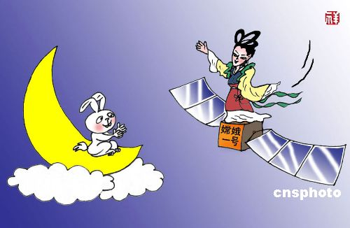

Slide 2
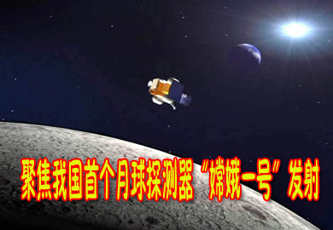

Slide 3
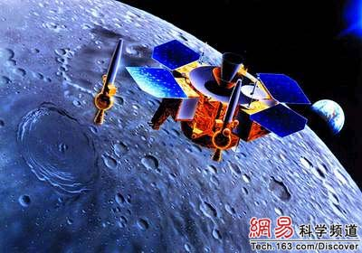

Slide 4
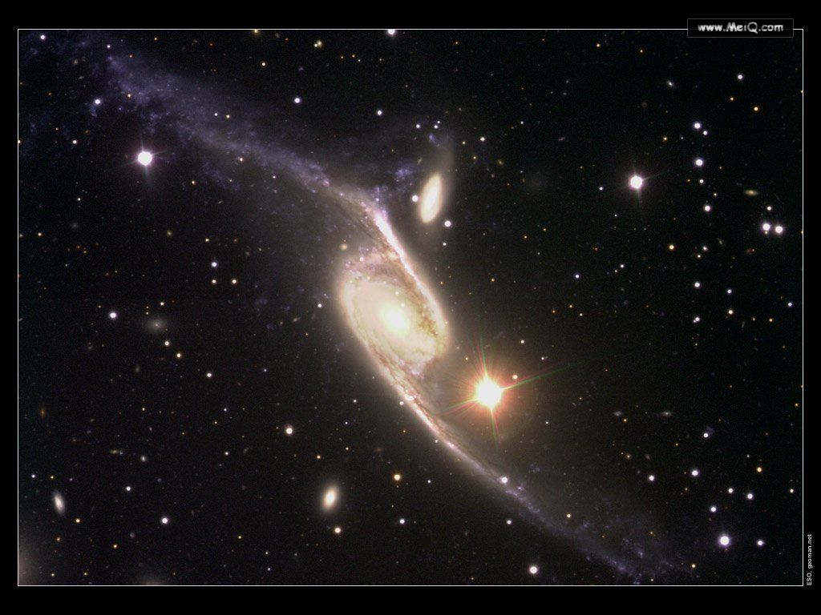

Module 5
The Conquest of the Universe

Slide 5
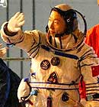
1)What is the name of this Chinese man?
2)How much do you know about him?
3) When was he sent into space and what did he do in space?
Yang Liwei
He was born in 1965 in Liaoning Province.
In 2003, he took some pictures and did some research about space.

Slide 6
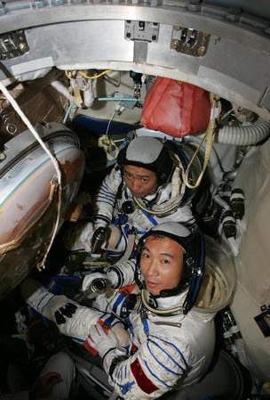
1)Who are they?
2)What are they famous for?
3)When were they sent into space and how long did they stay there?
Fei Junlong and Nie Haisheng
They were sent into space by ShenzhouⅥ.
On October 12, 2005. /119 hours

Slide 7
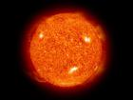
solar system

Slide 8
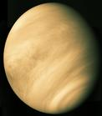
Venus(金星）

Slide 9
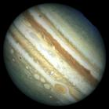
Jupiter (木星）

Slide 10
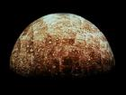
Mercury(水星)

Slide 11
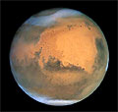
Mars(火星)

Slide 12
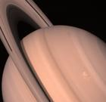
Saturn(土星)

Slide 13
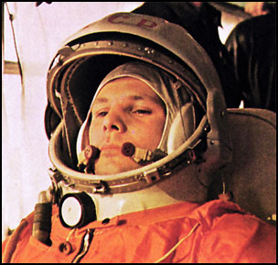
Introduction
Russian Yuri Gagarin becomes the first man in space. It takes him just 108 minutes to go around the world. The
date is _____.
1961

Slide 14
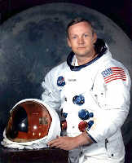
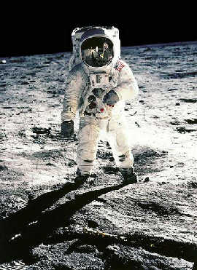
American Neil Armstrong becomes the first man to set foot on the moon. He describes the moment as “One small stepfor man, one giant leap for mankind. The date is:______.
1969

Slide 15
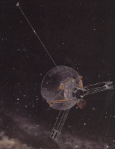
Pioneer 10 becomes the first spaceship to fly past Jupiter. It is headed for the red star Aldebaran, which it will reach in two million years’ time. The date is ______.
1973

Slide 16
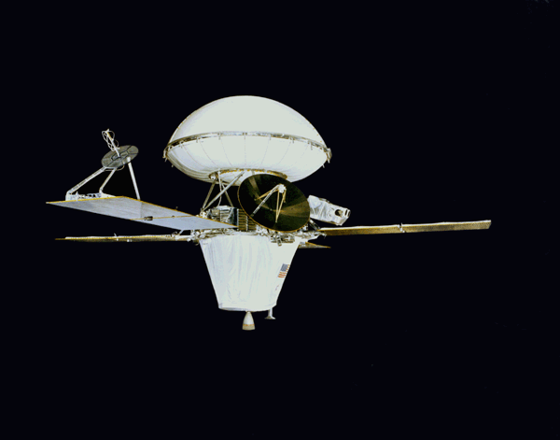
The American Viking 1 mission lands on Mars and sends back good quality photo. The date is _____ .
1975

Slide 17
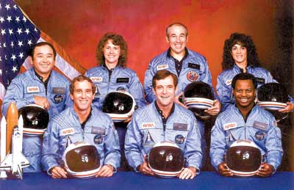
Seven American astronauts are killed just over a minute after taking off in Challenger. It is the biggest space disaster so far, and slows down the American space
programme.The date is ______.
1986

Slide 18
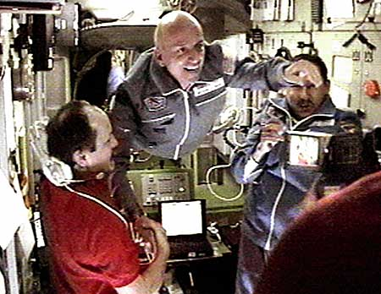
A 60-year-old American, Denis Tito, becomes the first space tourist. He spends eight days on board the Russian part of a joint USA-Russia space mission. The date is _____.
2001

Slide 19
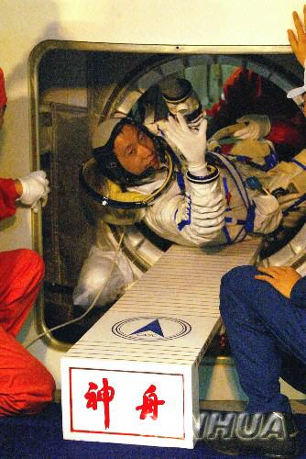
Yang Liwei becomes the first Chinese astronaut. He describes the experience as marvelous. The date is :_____.
2003

Slide 20
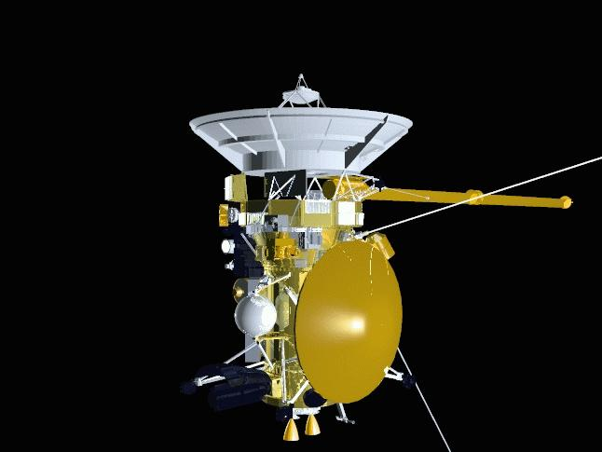
Nearly seven years after being launched , the Cassini space probe reaches Saturn. It sends beautiful images of Saturn’s rings back to Earth. The date is _____.
2005

Slide 21
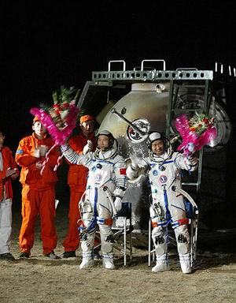
2005 --ShenzhouⅥ

Slide 22
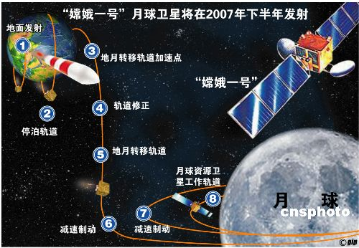
2007--China’s First Lunar Probe “Chang’e 1”

Slide 23
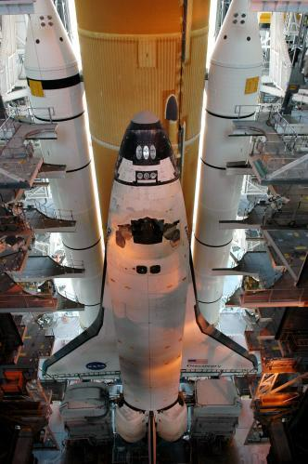
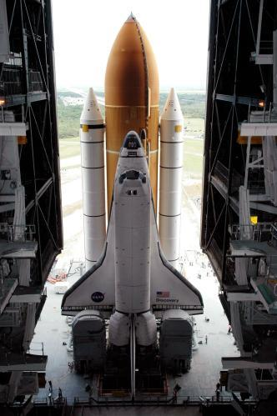
Preparation for the launching of the spaceship

Slide 24
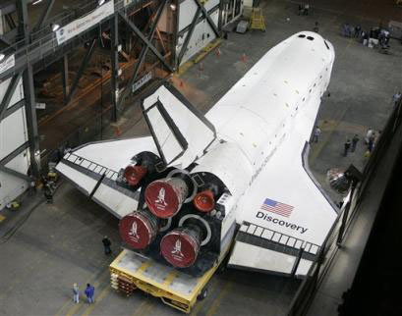
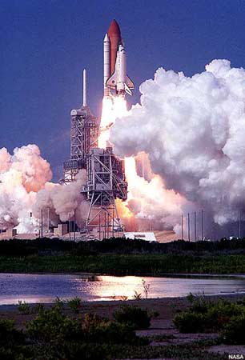
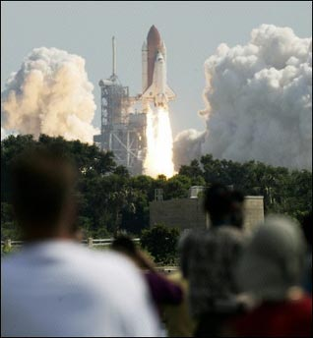
Launching of the spaceship

Slide 25
What will happen in the future?
Time in the future | Events that will happen
2010-2020
2020-2030
2030-2040
2040-2050
2050-2060

Slide 26
Discussion
What will you do in the future in space?
Such as spend my holidays in space
Set up a base for scientific research
To be an astronaut to be sent into Mars.
…

Slide 27
Pre-reading
accustomed
shuttle
historic
tune
witness
adj.习惯的
n.航天飞机
adj.历史性的
v.收看，收听
v.目击，亲历

Slide 28
assume
patience
in spite of
advanced
at the very beginning of
burst
v.假定，假设
n.耐心
不管
adj.高级的，先进的
在……一开始的时候
v.爆炸

Slide 29

Fast-reading
Tick the subjects that are mentioned in the text:
(1) the first landing on the Moon
(2) the first shuttle flight into space
(3) the first landing on Mars
(4) the explosion of the challenger
(5) China’s first taikonaut Yang Liwei

Slide 30
Find out the main idea of each part.
Part 1:
Para 1: the first Moon landing
Para 2: the first shuttle flight into space
Para 3: the explosion of the Challenger
Part 2:
The writer’s witness of the explosion of the Challenger.

Slide 31
Careful-reading
1
1.Why does the writer call the passage Space: the Final Frontier?
Because there are no new places left on Earth for humans to discover but we have not yet explored space.
2. How did people feel when they watched the first moon landing?
Excited but nervous.

Slide 32
3. How did people feel about space travel a few years later?
They got used to it and thought it was safe and normal.
4.What was different about the space shuttle?
The space shuttle could be used many times.

Slide 33
5. Why did people want to watch the Challenger take off?
Because it was a new spacecraft and it had a teacher on board as well as astronauts.
6. What did the Challenger disaster teach the world?
Space flight was still dangerous.

Slide 34
True or false
(1) Armstrong is the first one to set foot on the moon back in 1969.
(2) Space shuttle could only be used for once.
(3) The aim of the Columbia was to test the new shuttle system.
(4) The Challenger took off on 12th April, 1981.
(5) Christa McAuliffe never came back to her classroom.
T
F
T
F
T

Slide 35
1. How the boy felt before the take-off？
He was very excited.
2. What happened when the Challenger exploded？
They all started screaming.
2

Slide 36
3. How he felt after witnessing the accident on TV？
He was in a state of shock.
4. What he thought about space travel a few weeks later？
He was not sure it was worth exploring space if people were going to die.

Slide 37
3
accustomed assume civilian enthusiastic explore mankind patience shuttle witness
1.to see something happen, for example an important event, or a crime ________
2.to think that something is true,even if you are not sure ________
3.a vehicle that goes to a place and comes back _______
witness
assume
shuttle

Slide 38
4. an ordinary person who is not in the armed forces or the police __________
5. To burst with a lot of force and loud noise _________
6. Very interested in something or excited by it ____________
7.the ability to stay calm,especially when you have to wait for something _________
8.all the people in the world _________
9.getting used to something ___________
civilian
explode
enthusiastic
patience
mankind
accustomed

Slide 39
Post-reading
Part 1:
Main idea and how the author manage to show its main idea.
It mainly tells us about human exploration of the universe by showing us the greatest events which marked the historic stages in this field, presenting his ideas and facts by following the time line of these events.

Slide 40
Part 2:
The author gives us a close description of the Challenger accident through the eyes of a boy witness. The changes of his feelings about the event bring the disaster back to life.

Slide 41
Would you like to go on a journey into space? Why/Why not?
Discussion

Slide 42
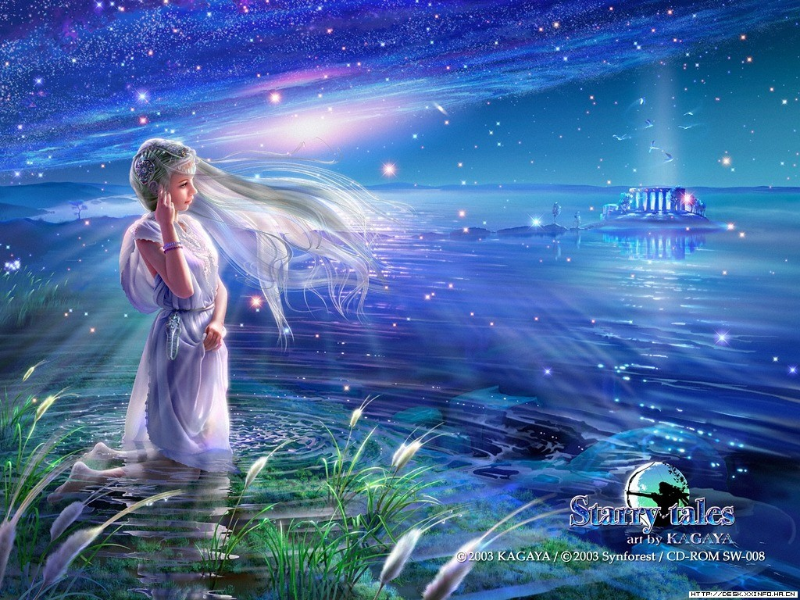
Thank you !
Bye-bye

